Slide 1
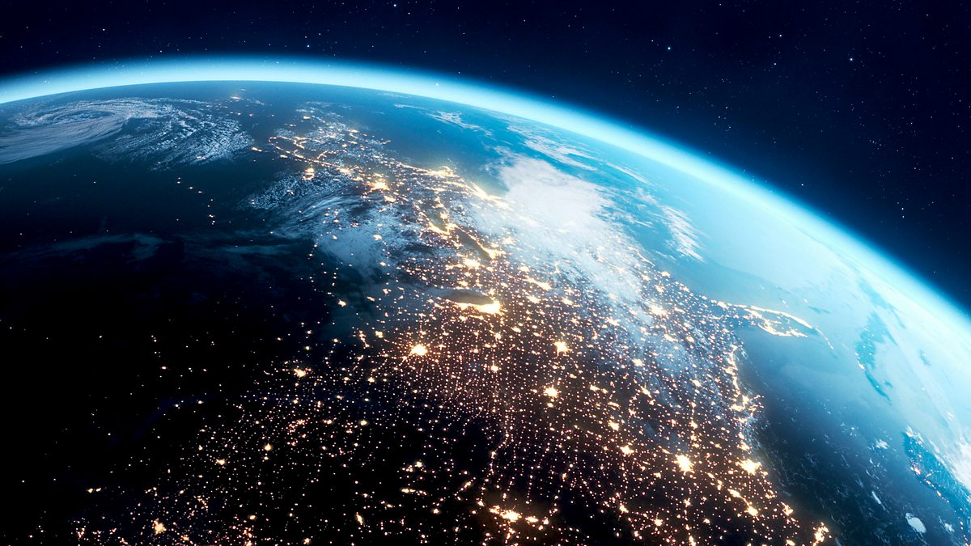
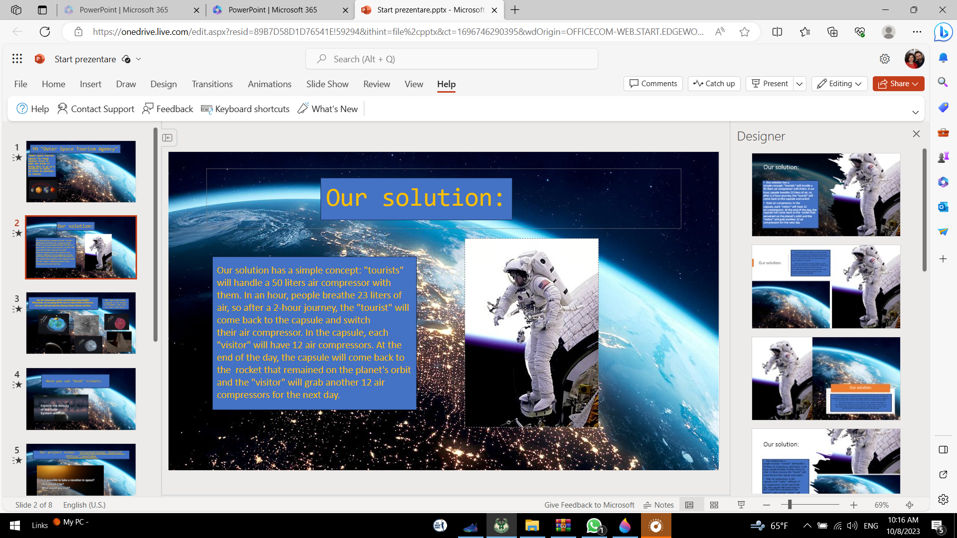
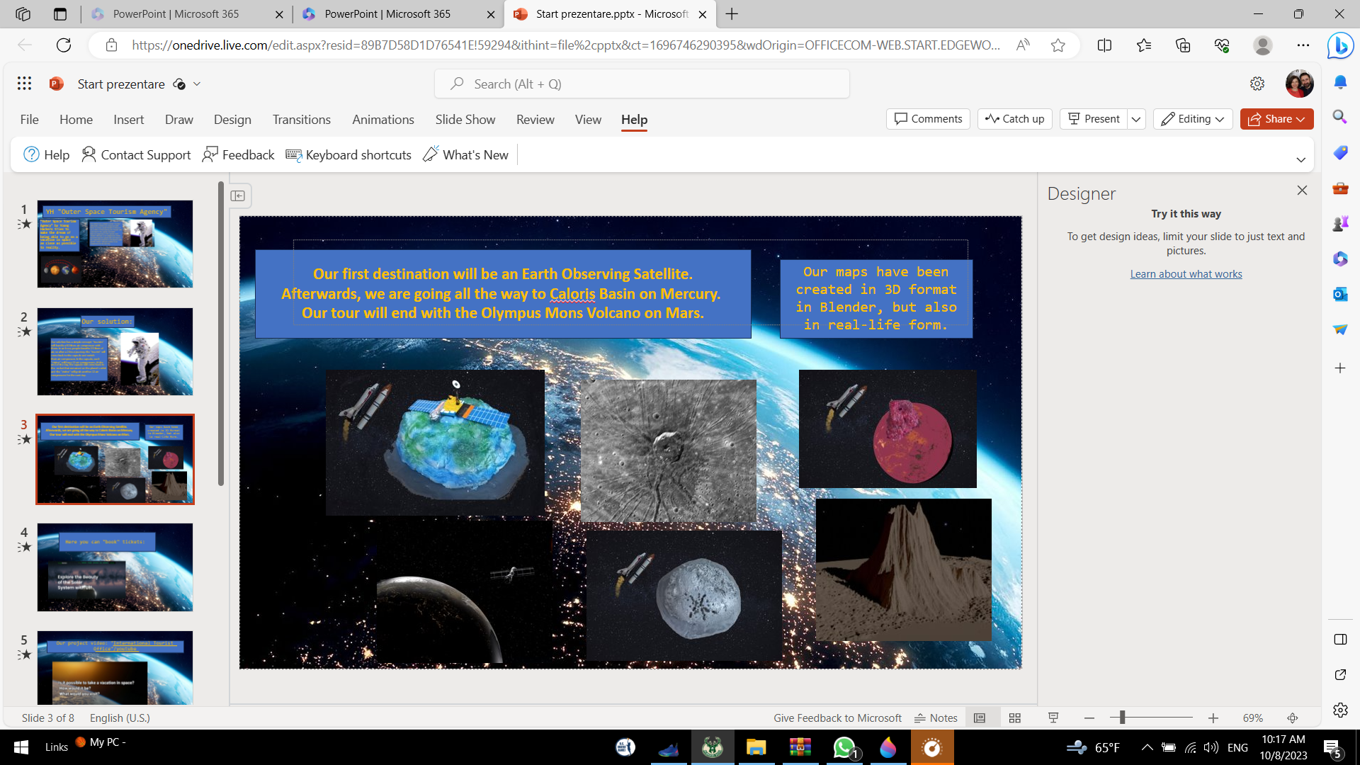
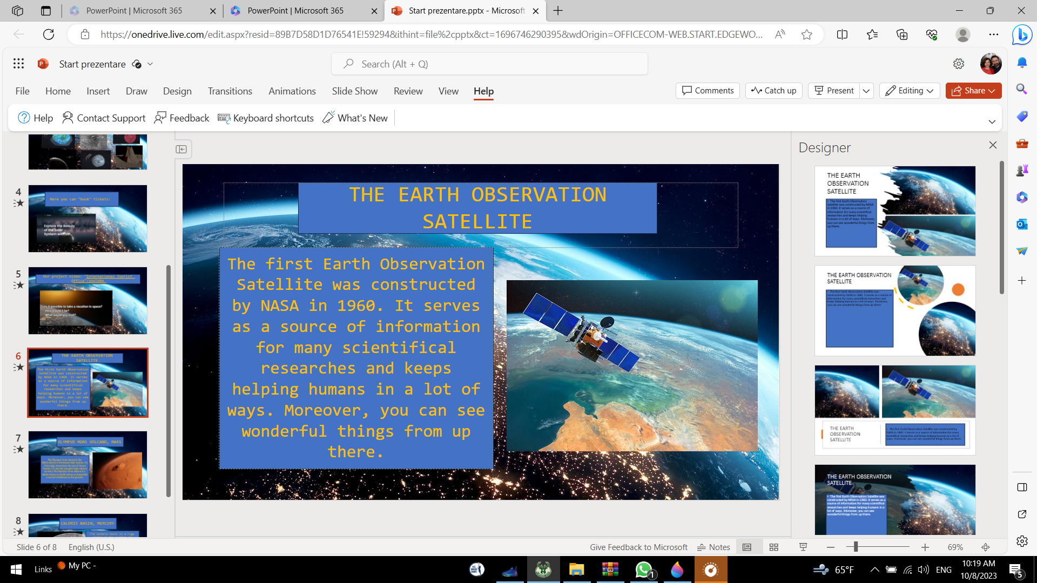
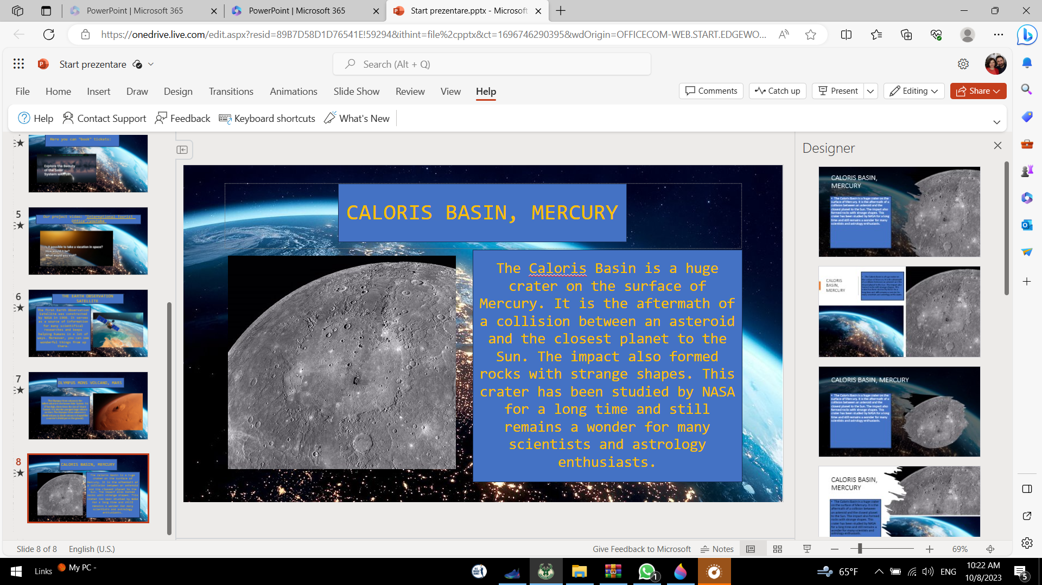
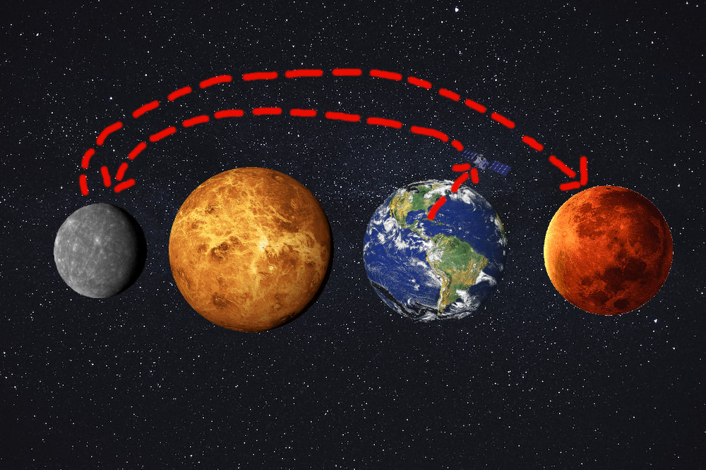
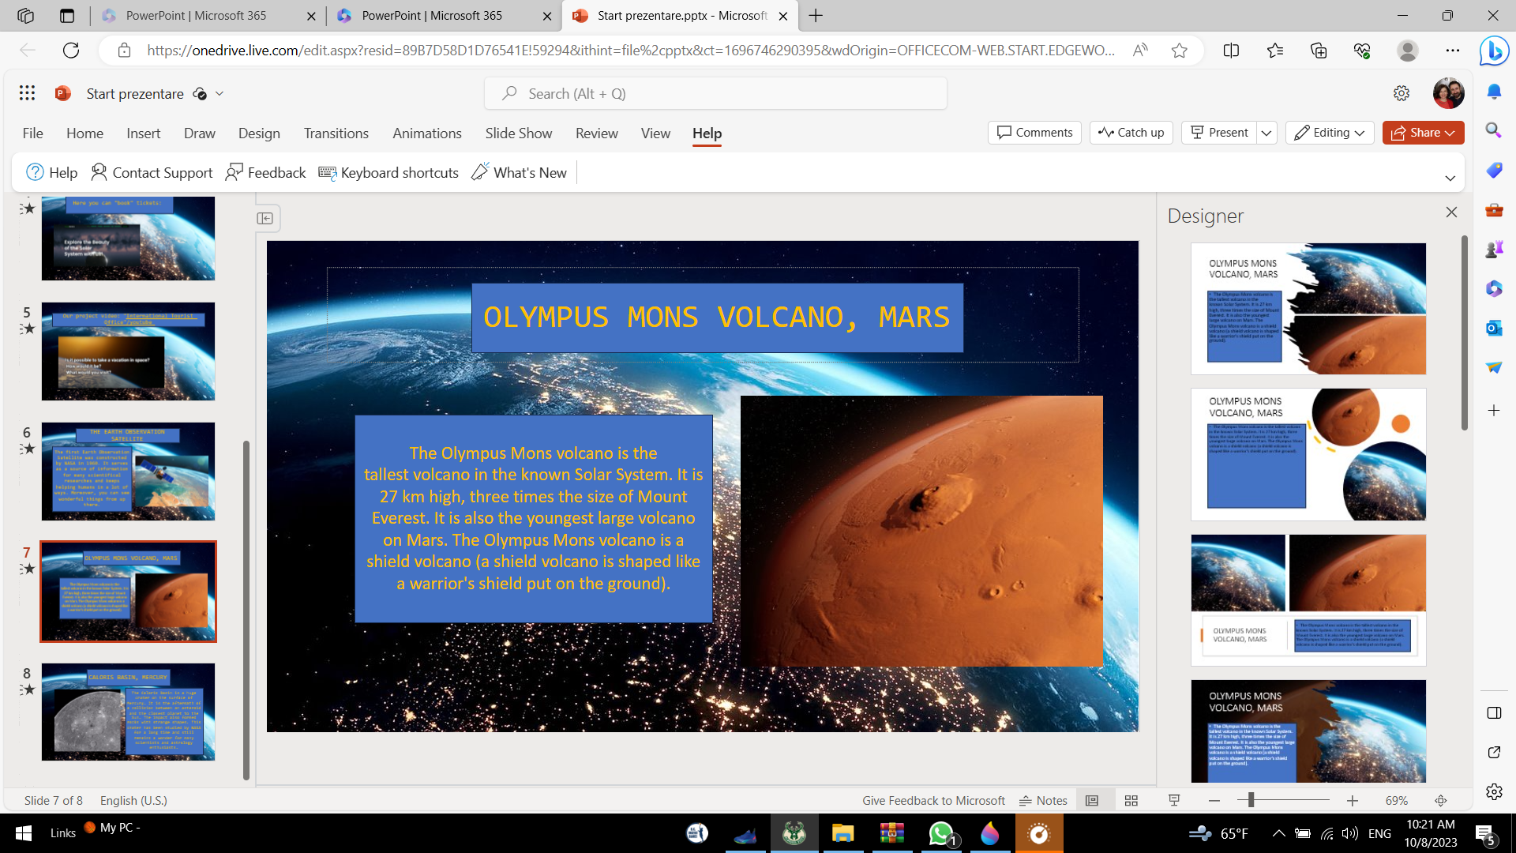
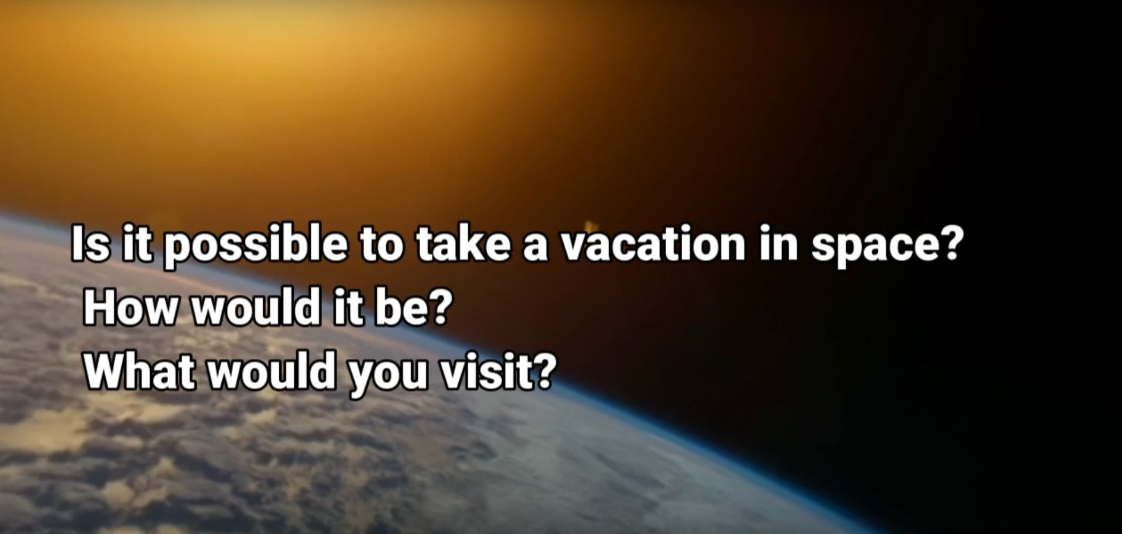
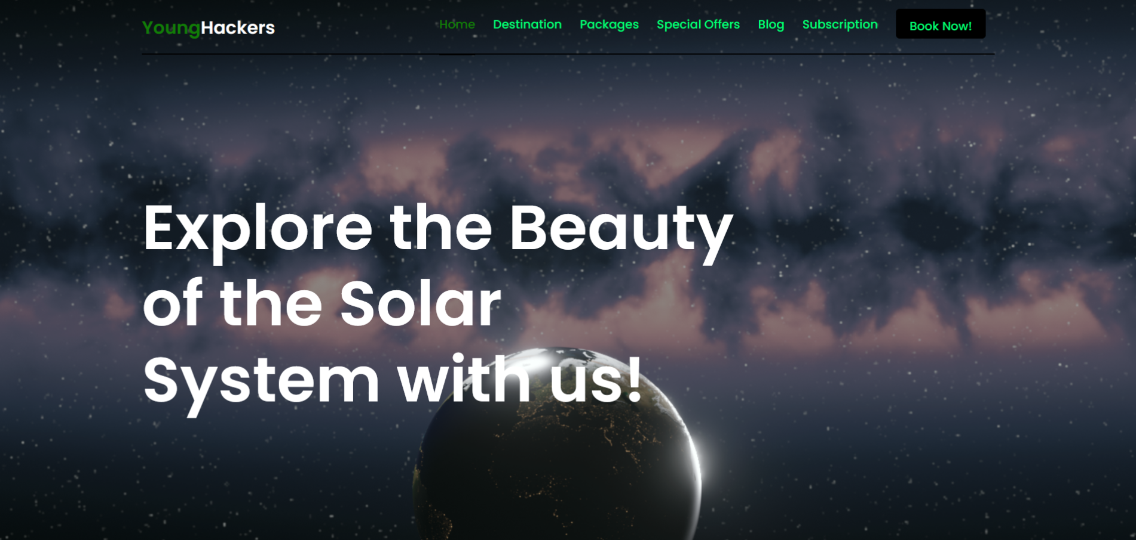
YH "Outer Space Tourism Agency"
"Outer Space Tourism Agency" by Young Hackers tries to make the dream of being able to go on a vacation in space
as close as possible to reality.
Thank you!

Slide 2
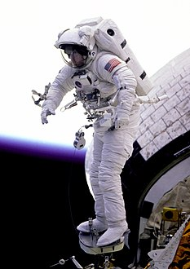
Our solution:
Our solution has a simple concept: "tourists" will handle a 50 liters air compressor with them. In an hour, people breathe 23 liters of air, so after a 2-hour journey, the "tourist" will come back to the capsule and switch
their air compressor. In the capsule, each "visitor" will have 12 air compressors. At the end of the day, the capsule will come back to the rocket that remained on the planet's orbit and the "visitor" will grab another 12 air compressors for the next day. For handling the pressure, the "tourist" will use a suit that is compatible with the atmosphere of every destination.

Slide 3
YH "Outer Space Tourism Agency"
"Outer Space Tourism Agency" by Young Hackers tries to make the dream of being able to go on a vacation in space
as close as possible to reality.
Thank you!

Slide 4
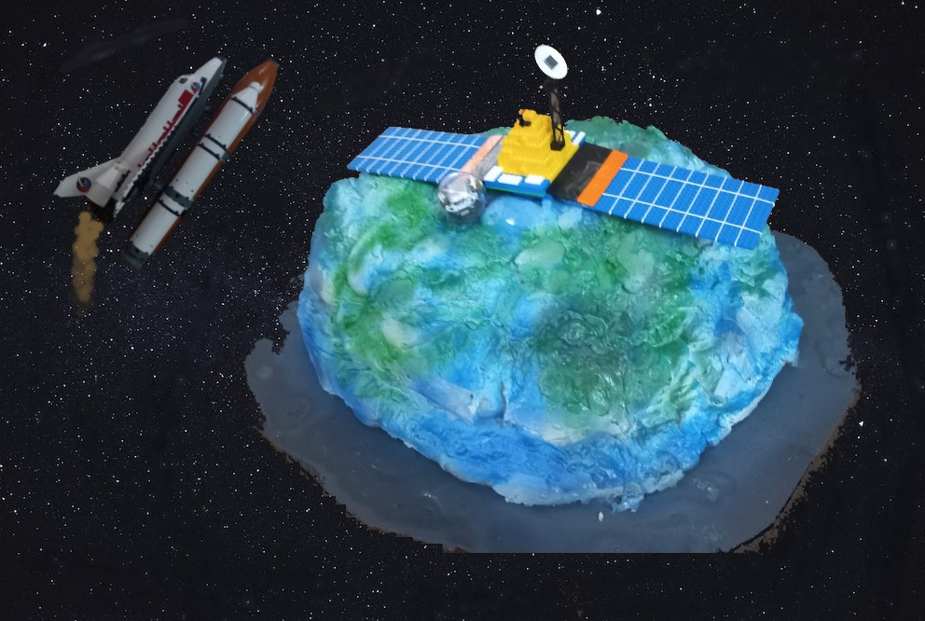
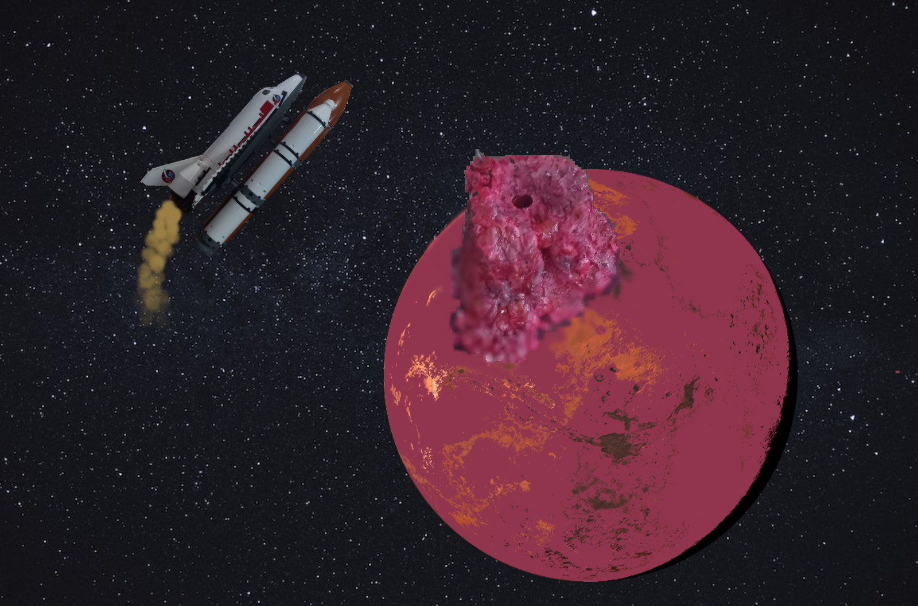
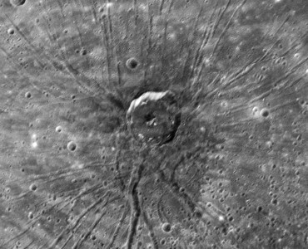
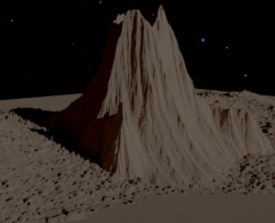
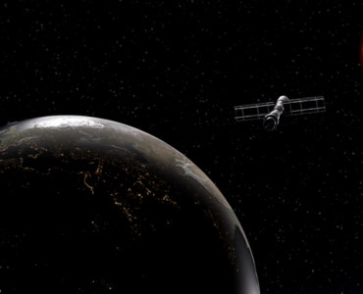
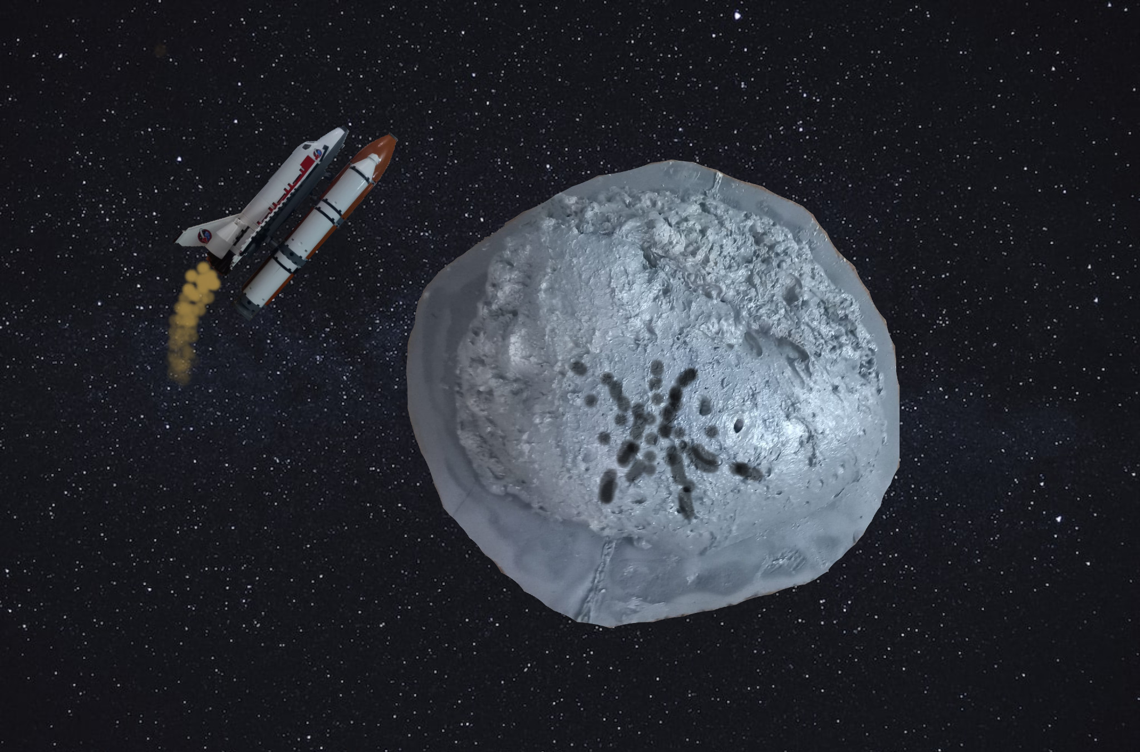
Our first destination will be an Earth Observing Satellite. Afterwards, we are going all the way to Caloris Basin on Mercury.
Our tour will end with the Olympus Mons Volcano on Mars.
Our maps have been created in 3D format in Blender, but also in real-life form.

Slide 5
YH "Outer Space Tourism Agency"
"Outer Space Tourism Agency" by Young Hackers tries to make the dream of being able to go on a vacation in space
as close as possible to reality.
Thank you!

Slide 6
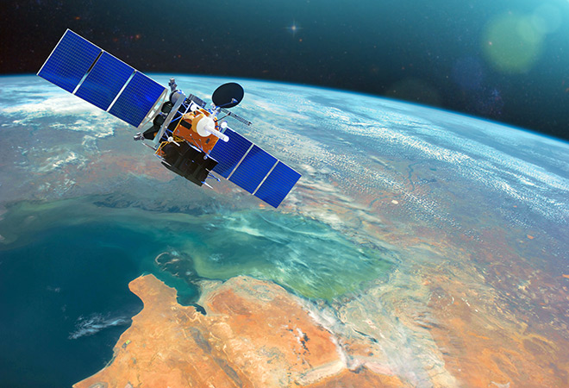
THE EARTH OBSERVATION SATELLITE
The first Earth Observation Satellite was constructed by NASA in 1960. It serves as a source of information for many scientifical researches and keeps helping humans in a lot of ways. Moreover, you can see wonderful things from up there.

Slide 7
YH "Outer Space Tourism Agency"
"Outer Space Tourism Agency" by Young Hackers tries to make the dream of being able to go on a vacation in space
as close as possible to reality.
Thank you!

Slide 8
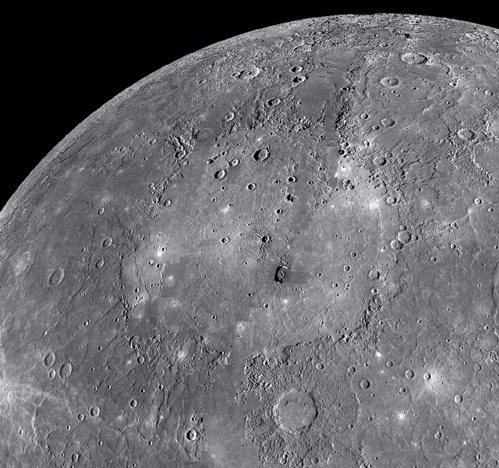
CALORIS BASIN, MERCURY
The Caloris Basin is a huge crater on the surface of Mercury. It is the aftermath of a collision between an asteroid and the closest planet to the Sun. The impact also formed rocks with strange shapes. This crater has been studied by NASA for a long time and still remains a wonder for many scientists and astrology enthusiasts.

Slide 9
YH "Outer Space Tourism Agency"
"Outer Space Tourism Agency" by Young Hackers tries to make the dream of being able to go on a vacation in space
as close as possible to reality.
Thank you!

Slide 10
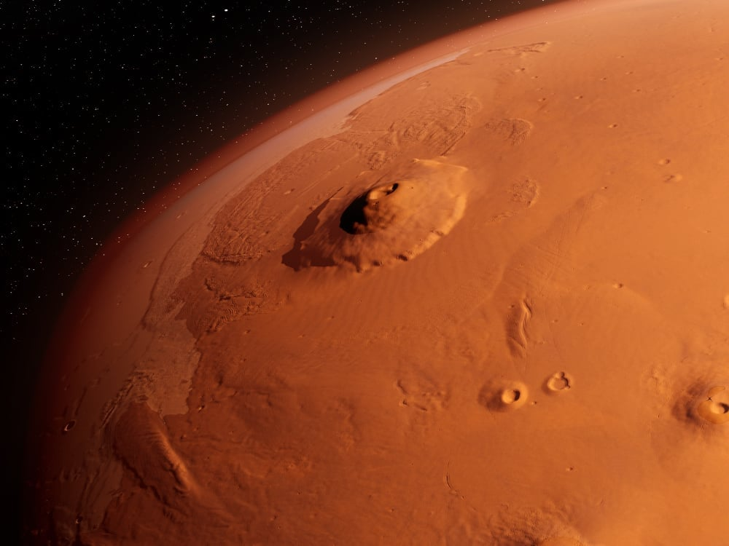
OLYMPUS MONS VOLCANO, MARS
The Olympus Mons volcano is the tallest volcano in the known Solar System. It is 27 km high, three times the size of Mount Everest. It is also the youngest large volcano on Mars. The Olympus Mons volcano is a shield volcano (a shield volcano is shaped like a warrior's shield put on the ground).

Slide 11
YH "Outer Space Tourism Agency"
"Outer Space Tourism Agency" by Young Hackers tries to make the dream of being able to go on a vacation in space
as close as possible to reality.
Thank you!

Slide 12
Our project video: "International Tourist Office"/youtube

Slide 13
YH "Outer Space Tourism Agency"
"Outer Space Tourism Agency" by Young Hackers tries to make the dream of being able to go on a vacation in space
as close as possible to reality.
Thank you!

Slide 14
Here you can "book" tickets:yhouterspacetourismoffice

Slide 15
YH "Outer Space Tourism Agency"
"Outer Space Tourism Agency" by Young Hackers tries to make the dream of being able to go on a vacation in space
as close as possible to reality.
Thank you!

Slide 16
THANK YOU!

